Slide 1


ONLINE EXAMINATION

Slide 2

KADI SARVA
VISHWAVIDYALAYA
BHOLABHAI PATEL COLLEGE OF COMPUTER STUDIES
GANDHINAGAR
BCA SEMESTER – VI
BCA – 605
“Project Phase – 2”
ONLINE EXAMINATION SYSTEM
SUBMITTED BY
Sr | En.No | Name | Roll.No
1 | 18BCA04280 | Patel Trusha P | 18113
2 | 18BCA04295 | Patel Vidhi B | 18114
3 | 18BCA04102 | Raval Gopi R | 18122

Slide 3
B. P. College of Computer Studies
A Constituent College of KADI SARVA VISHWAVIDYALAYA
Certificate
This is to certify that the project report compiled by :
1. Patel Trusha Pankajbhai
2. Patel Vidhi Bharatbhai
3. Raval Gopi Rakeshbhai
Student of semester – VI from BCA department, B. P. College Of Computer Studies, a Constituent college of KADI SARVA VISHWAVIDYALAYA, Gandhinagar is done under our guidance. To the best of our knowledge, this work is satisfactorily completed. During the tenure, they were found to be very hard working and sincere. They completed all tasks assigned and suggested to them.

Slide 4
INDEX
Task | Phase Of Project
1 | Project Title Project Definition Project Scope / Project Objective Technology Used
2 | Existing System Advantages and Disadvantages of existing system Existing Limitation Operational level problem Technical level problem Informational level problem
3 | Proposed system Propose system Advantages and Disadvantages SRS including function requirement and non functional requirement Feasibility study(operational, Technical, Economical, Scheduled)
4 | Propose system modules Context , First and Second Level DFD
5 | E- R Diagram
6 | Data Directory

Slide 5
Project Title
Online Examination System

Slide 6
Project Defination
Online Examination System (OSI) is a Multiple Choice Questions (MCQ) based examination system that provides an easy to use environment for both admin and Students appearing for Examination.
Test Conductors are responsible for preparing subjects, tests and questions.

Slide 7
Project Objectives
General objective of our project is to change current manual system into computerized.
The project would be very useful for educational institutes where regular evaluation of student’s is required.
It reduces time consummation.
Being an integrated Online Examination System reduces paper work.
The website to conduct Online Examination System is “Online MCQ Test”. This website provides facility to institutes to conduct Online MCQ Test by providing a unique id to each institute. The institutes also enters the list of eligible students. All the information entered can be later edited by the institute. In turn student can login with their id, name and instituted to give the exams and can view their result then and there. Institutes can also view the result of their students.

Slide 8
Project Scope
Can be used anywhere and anytime as it is a web based application (User location doesn’t matter).
No restriction that examiner has to be present when the candidate takes the test.
Design to facilitate Admin and Students.
Online Examination is design for educational institutes like Schools, colleges, and private institutes to conducts logic test of their students or employees on regular basis.
We work on only MCQ based examination system not for VSQ and long question.

Slide 9
Project Technology
Software developed in HTML,CSS PHP,JAVASCRIPT and MYSQL.Work on Sublime Text and XAMMP web server and Google Chrome
The Online Examination is multi-platform compatible. It will work on any computer or operating system which has MYSQL, XAMMP, PHP installed.

Slide 10
Existing System
We are find existing system is manual entry and keeping of the details of the student who are registered already. And it is very difficult to come to the exam centre.
This system is required to prepare registration/application from, question paper for the students and required to print a lot of number manually.
To calculate how many students registered, and verification of details of these students in a month by hand is very difficult.

Slide 11
Disadvantages of Existing System
Time consuming for creating question paper.
A lot of tabulation work for each subject results.
Human error.
Limitation of numbers of student can give examination at a time
Student needs to come exam centre for giving test or exam.
A lot of copies of question papers have to be made.
Wastage of papers.
Advantages of Existing System
Requirement of hardware and software is very less.
Internet is not mandatory.

Slide 12
Existing Limitation
Operational level problem:
Paper wastages because of paper work.
Because of offline mode scope is limited.
Due manually storage it is not safe.
Technical level problem:
No technical level problems.
Informational level problem:
Faculty have to write marks manually.
Difficult to retrieve old marks.
Time consuming process.

Slide 13
Proposed System
This website is used to conduct online examination.
The students can sit at individual terminals and login to write the exam in the given duration. The questions have to be given to the students.
This website will perform correction, display the result immediately and also store it in database.
This website provides the administrator with a facility to add new exams.
This website provides the Instructor add questions to the exam, modify questions in the exam in a particular exam.
This website takes care of authentication of the administrator, Instructor as well as the students.

Slide 14
Advantages of Propose System
Time Management
Cost Saving
Accessibility and Flexibility
Security and Confidentiality
Easy accessibility
Environmentally friendly
Disadvantages of Propose System
Require high speed internet
Chances of server crashes
Chances of hacking

Slide 15
SRS [System Requirement Specification]
1) Functional Requirement :
Hardware Requirements:-
Pentium-IV(Processor).
256 MB Ram
512 KB Cache Memory
Hard disk 10 GB
Microsoft Compatible 101 or more Key Board
Software Requirements:
Operating System : Windows
Web-Technology: PHP
Front-End: HTML,CSS,JAVASCRIPT
Back-End: MySQL
Web Server: Apache SERVER.

Slide 16
2)Non-Functional Requirement :
Preview
Security
Question, Subject
Easy Function
The system may get crashed at any certain time due to virus or operationting system failure.Therefore,it is required to take the database backup.

Slide 17
Feasibility Study
1)Technical Feasibility:
Proposed platform has sufficient capacity for future needs and it is easy to expand.
Need technical expertise for maintaining system particularly internet connection.
The website is able to handle future transaction volume and future growth.
Organization has already available hardware and internet.

Slide 18
2)Operational Feasibility:
Management and user support the system.
The website reduces the work of the users and faculty and make data storage effective.
Operational feasibility is mainly concerned with issues like whether the system with be used if it is developed and implemented.
These modules are operational feasible because we have technical skilled persons who can built these modules is very easy to understand and very to implement with the existing infrastructure. Therefore operational activities are very fast, so the modules can be developed in minimum time fewer efforts.
3)Economical Feasibility:
Economical analysis is most frequently used for evaluation of the effectiveness of the system.
More commonly known as cost/benefits analyses is the procedure to determine the benefit and saving that are expected from a system and compare them with costs, decision is made to design and implement the system.
This project is economical feasible because we are using existing tools and software to developed it. We do not need to buy any other software. We are going to use following tools and software:
XAMP
Notepad ++

Slide 19
Modules :
1.ADMIN MODULE
2.INSTRUCTOR MODULE
3.STUDENT MODULE
1.ADMIN MODULE:
1.REGISTER
2.LOGIN
3.CHANGE PASSWORD&FORGOTPASSWORD
4.STUDENT -MODIFING DETAILS
5.DEPARTMENTS-ENTERING/MODIFYING DETAILS
6.INSTRUCTOR DETAILS-MODIFYING DETAILS

Slide 20
2.INSTRUCTOR MODULE:
1.REGISTER
2. LOGIN
3CHANGE PASSWORD&FORGOT PASSWORD
4.ADD QUESTIONS-DEPARTMENTS VERIFING.
5.UPDATE QUESTIONS -DEPARTMENTS VERIFING
6.CREATE EXAMS
7.UPDATE EXAMS
8.VIEW EXAM DETAILS- VIEW NO OF REGISTERED STUDENTS
VIEW NO OF ATTENDED STUDENTS
9.EVALUATE QUESTION:MULTIPLE CHOICE
TUE/FALSE

Slide 21
3. STUDENT MODULE:
1.REGISTER
2.LOGIN
3.TAKE EXAM- MULTIPLE CHOICE
TRUE/FALSE
4. SEE EXAM RESULTS
5.LOGOUT

Slide 22
DATAFLOW DIAGRAMS:
CONTENT LEVEL:
LOGIN/REGISTRATION
LOGIN
TAKE QUIZE
ADD/REMOVE QUIZE
Online
examination
USER
GIVE RESULT
CREATE RESULT
SUBMIT TEST
CONFIRM LOGIN
CONFIRM LOGIN
ADMIN

Slide 23
USER
SAVE RECORD
FIRST LEVEL:
1.0
LOGIN/
REGISTER
LOGIN
LOGIN/REGISTER
USER
CONFIRM LOGIN/REGISTER
ADMIN
CONFIRM LOGIN
2.0
QUIZE
REQUEST FOR QUIZE
CONFIRM QUIZE
ADD QUIZE
SAVE RECORD
QUIZE
SCORE
3.0
VIEW SCORE
ADD SCORE
SAVE RECORD
HISTORY
4.0
FEEDBACK
GIVE FEEDBACK
FEEDBACK
SAVE RECORD
FEEDBACK

Slide 24
1.1
SECOND LEVEL:
USER
REGISTER
CHECK NEW USER
REGISTER
USER
CONFIRM
CONFIRM
ADMIN
1.2
UPDATE USER
REQUEST
UPDATE DETAILS
CONFIRM
ACCEPT
SEARCH FOR USER
1.3
PROCESS
SEARCH USER
CONFIRM
SAVE RECORD
FIND
1.4
VIEW USER DETAILS
REQUEST
CONFIRM
USER

Slide 25
OPTION
2.1
SAVE RECORD
CREATE QUIZ
QUESTIONS
ADD QUESTIONS AND OPTIONS
CONFIRM QUIZ
ADMIN
SAVE RECORD
USER
2.2
ADD
QUIZ
ADD NEW QUIZ
CONFIRM
REMOVE
QUIZ
2.3
REMOVE
CONFIRM
2.4
SHOW
QUIZ
GIVE QUIZE FORMAT
VIEW QUIZ
SAVE RECORD
QUIZ

Slide 26
HISTORY
3.1
SAVE RECORD
ANSWER
ANSWER
SAVE RECORD
ADD OPTIONS & ANSWERS
USER
ADMIN
CONFIRM
3.2
SUBMIT
ANSWER
REQUEST FOR SUBMIT
CHECK
GIVE RESULT
CONFIRM
3.3
SCORE
GIVE RANK
SHOW RANK
SAVE RECORD
4.0
RANK

Slide 27
E-R DIAGRAM:
A_id
A_pass
EMAIL
UNAME
COLLAGE
EID
SCORE
ADMIN
INTRO
EMAIL
TIME
TITLE
TOTLE
GIVE
HAVE
USER
QUIZ
RANK
MOBILE
HAVE
TIME
Password
DATE
EID
WRONG
SN
SHOW
QUESTIONS
QID
CHOICE
QUE
HAVE

Slide 28
QID
OPTIONS
OPTIONID
GIVE
OPTION
SELECT
TIME
FEEDBACK
QID
ANSWERS
EID
ANSID
FEEDBACK
SELECT
NAME
DATE
EMAIL
RETRIVE
HISTORY
SUBJECT
GIVE

Slide 29
Data Dictionary
ADMIN
Column | Type | Null | Default | Key
admin_id | int(11) | no |  | primary
email | varchar(50) | no
password | varchar(500) | no
ANSWER
Column | Type | Null | Default | Key
qid | text | no
ansid | text | no

Slide 30
FEEDBACK
Column | Type | Null | Key
id | text | no
name | varchar(50) | no
email | varchar(50) | no
subject | varchar(500) | no
feedback | Varchar(500) | no
date | date | no
time | varchar(50) | no

Slide 31
HISTORY
Column | Type | Null | KEY | Default
email | varchar(50) | no
eid | text | no
score | int(11) | no
level | int(11) | no
sahi | Int(11) | no
wrong | int(11) | no
date | timestamp | no |  | current_timestamp()

Slide 32
OPTION
Column | Type | Null | KEY
qid | varchar(50) | no
option | varchar(5000) | no
optionid | text | no
question
Column | Type | Null | KEY
eid | text | no
qid | text | no
qns | text | no
choice | int(10) | no
sn | int(11) | no

Slide 33
QUIZ
Column | Type | Null | KEY | Default
eid | text | no
title | varchar(100) | no
sahi | int(11) | no
wrong | int(11) | no
total | int(11) | no
time | bigint(20) | no
intro | text | no
tag | varchar(100) | no
date | timestamp | no |  | current_timestamp()

Slide 34
RANK
Column | Type | Null | Key | Default
email | varchar(50) | no
score | int(11) | no
time | timestamp | no |  | current_timestamp

Slide 35
USER
Column | Type | Null | key
name | varchar(50) | no
College | varchar(100) | no
email | varchar(50) | no | primary
mob | bigint(20) | no
password | varchar(50) | no

Slide 36
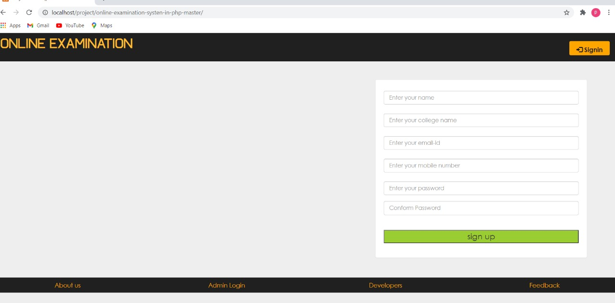
OUTPUT SCREEN:

Slide 37
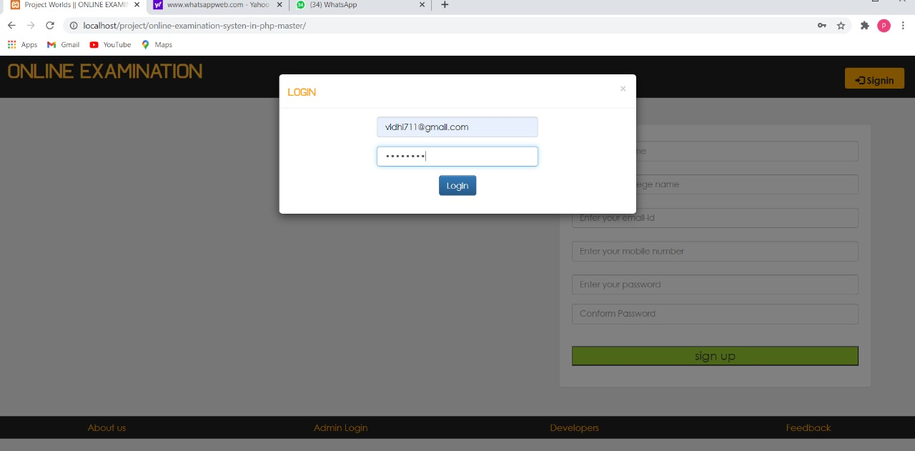

Slide 38
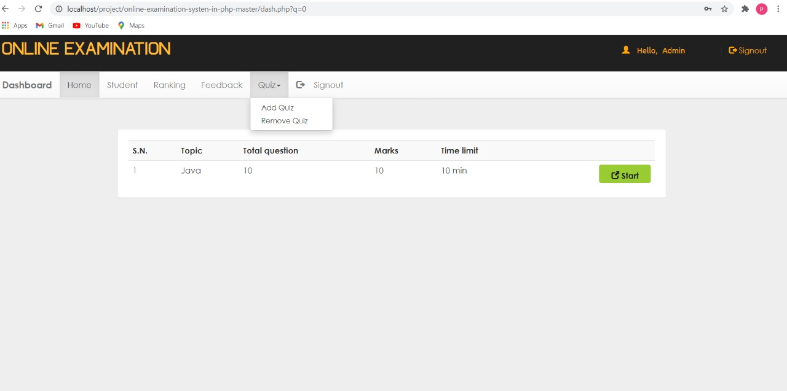

Slide 39
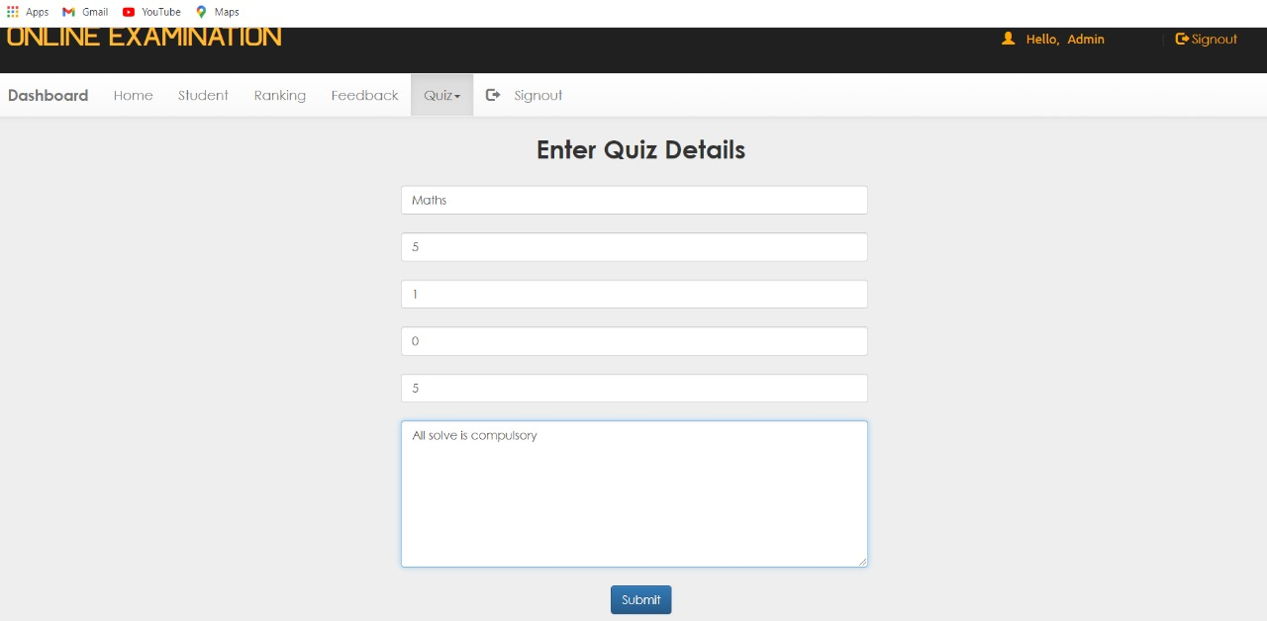

Slide 40
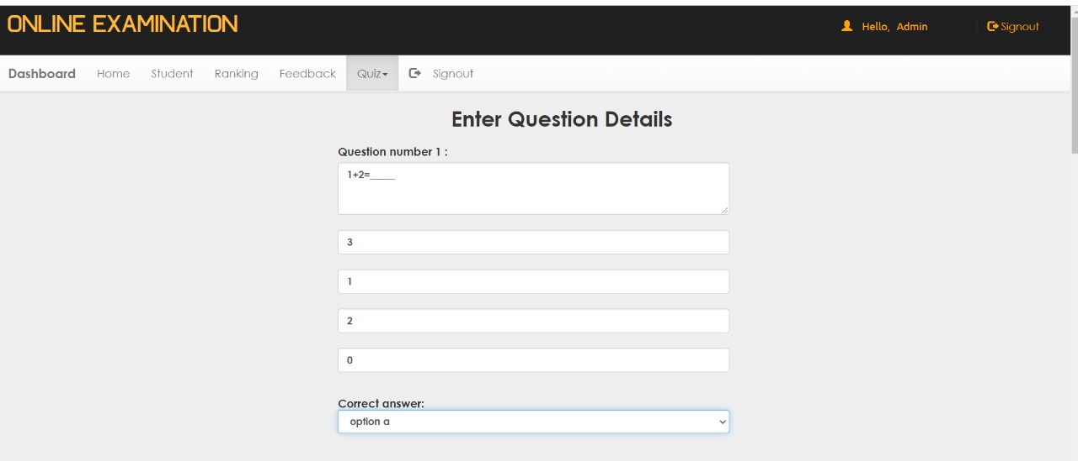

Slide 41
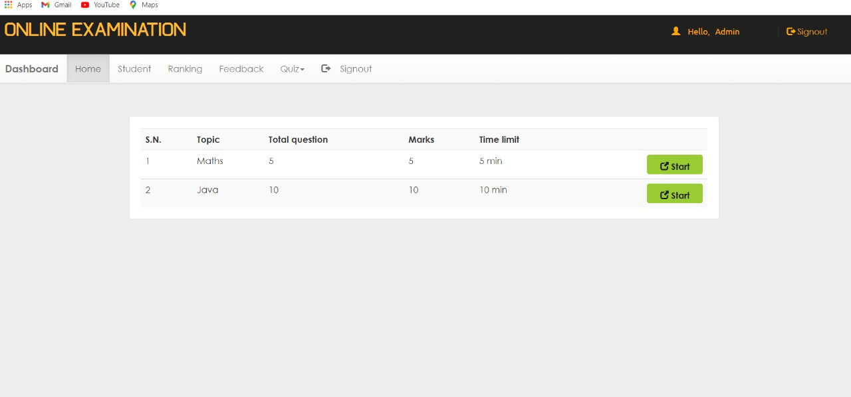

Slide 42
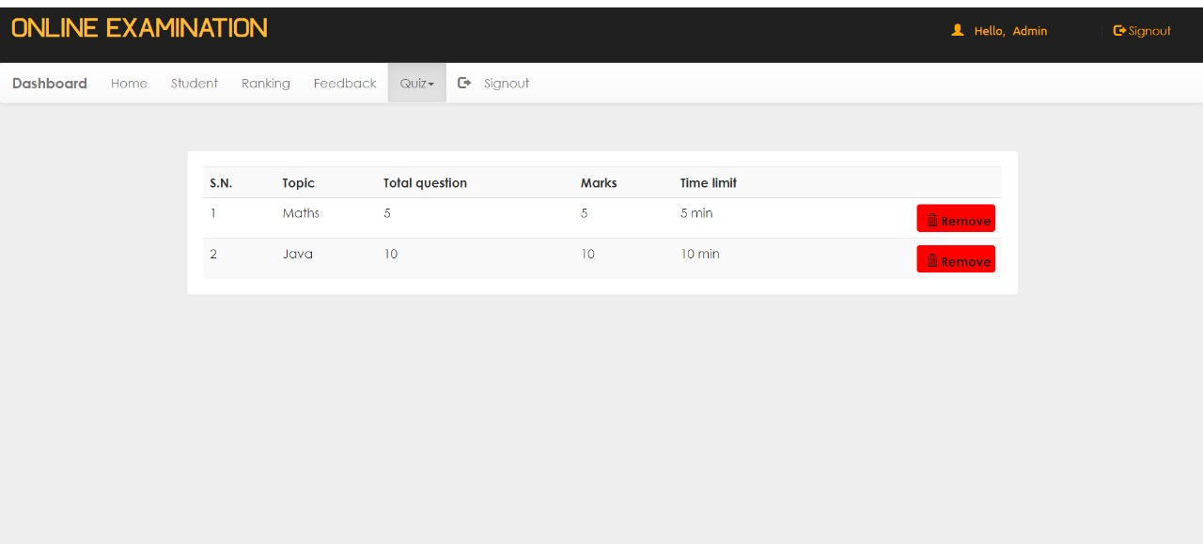

Slide 43
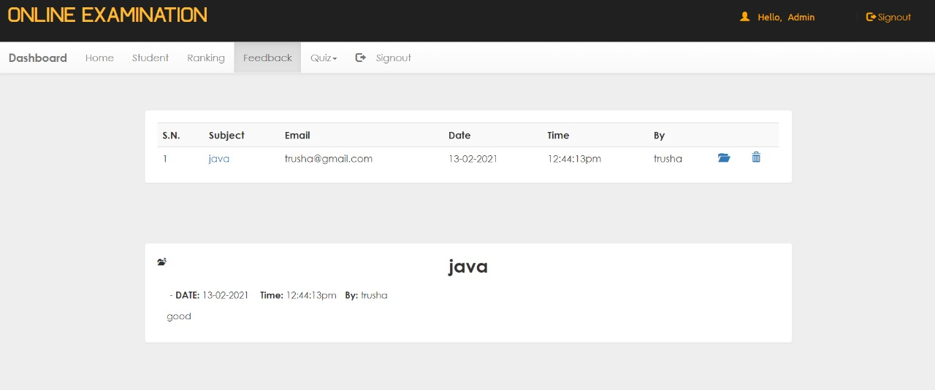

Slide 44
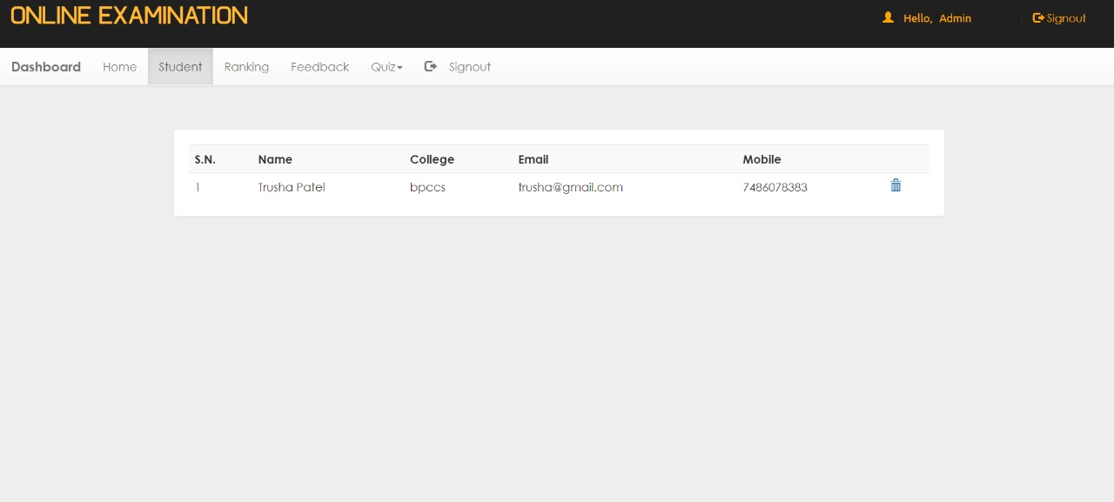

Slide 45
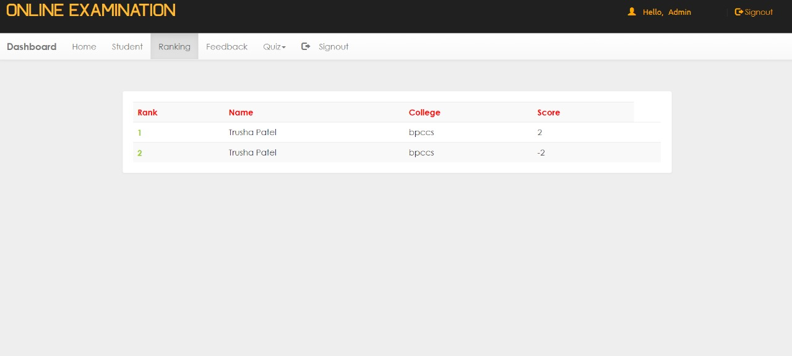

Slide 46
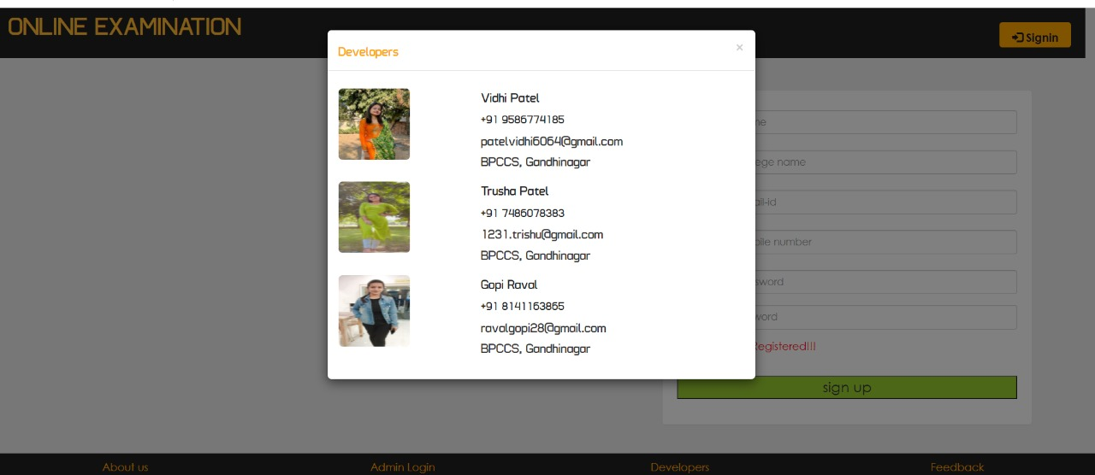

Slide 47
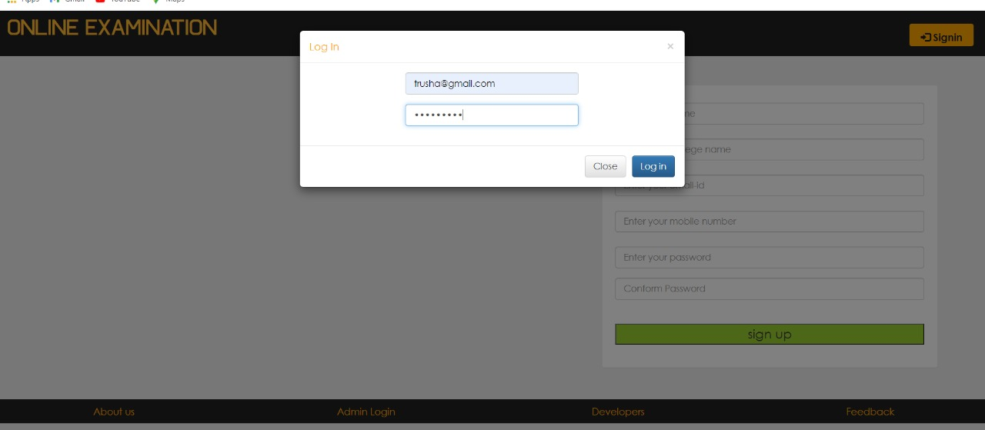

Slide 48
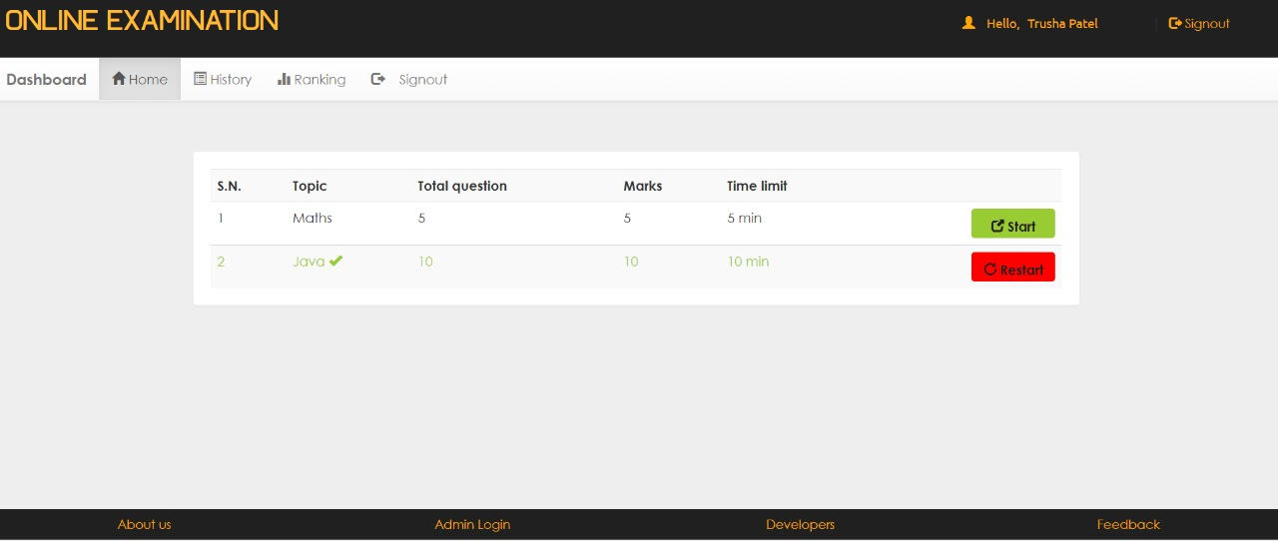

Slide 49
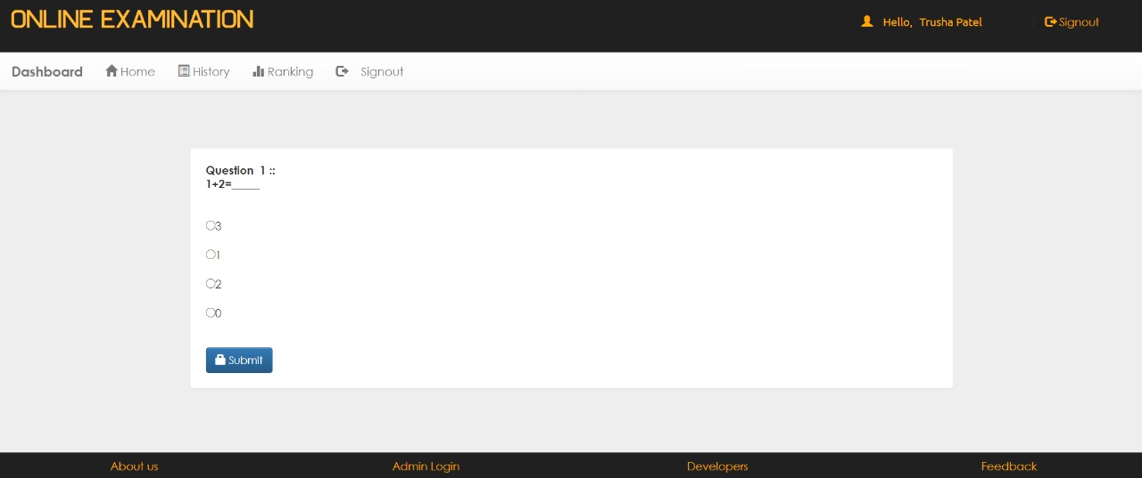

Slide 50
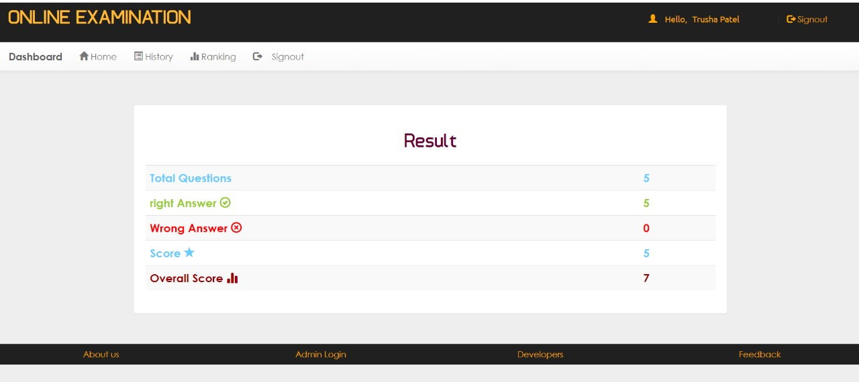

Slide 51
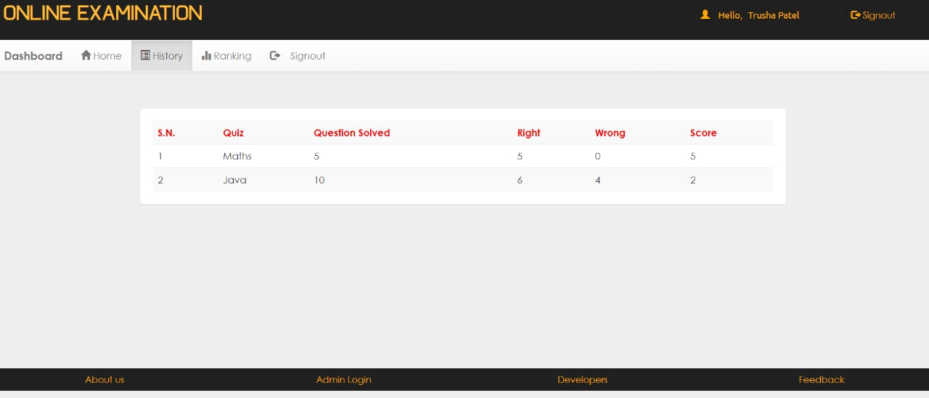

Slide 52
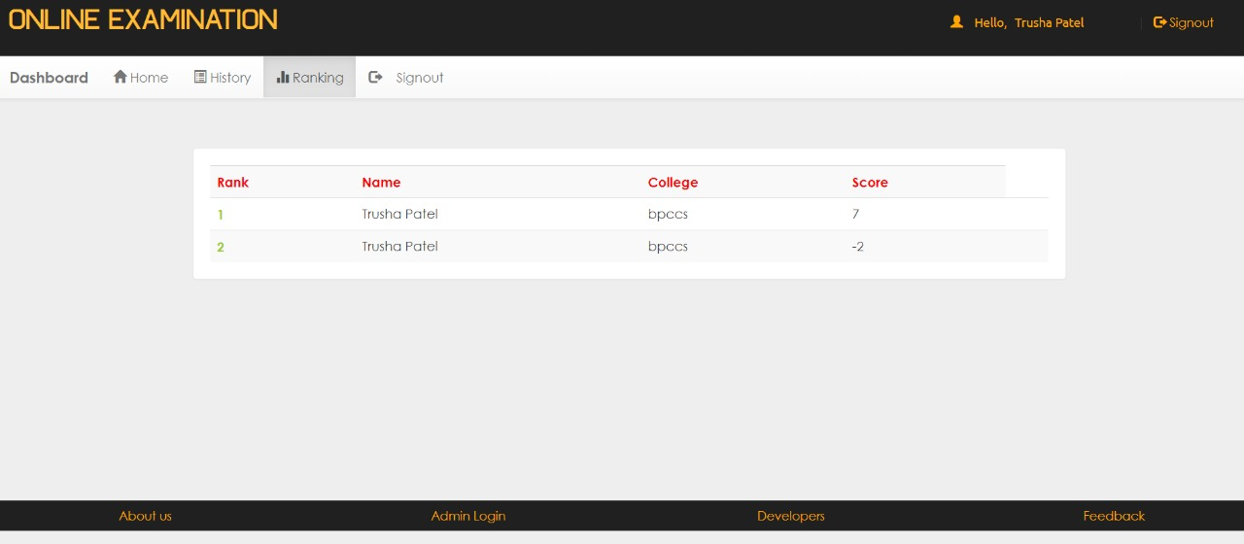

Slide 53
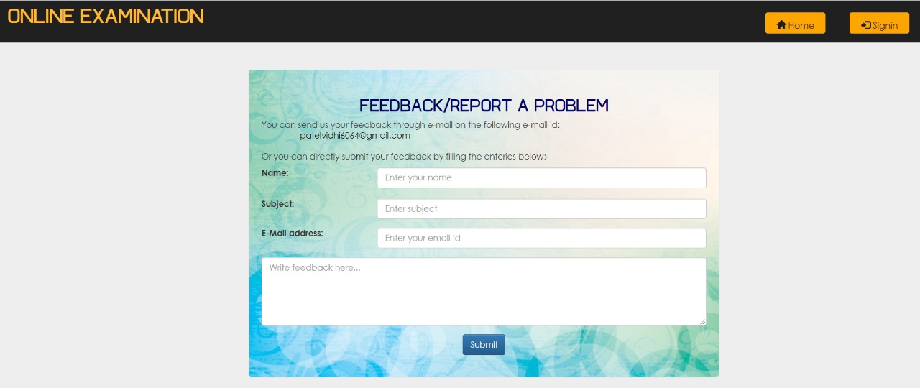

Slide 54
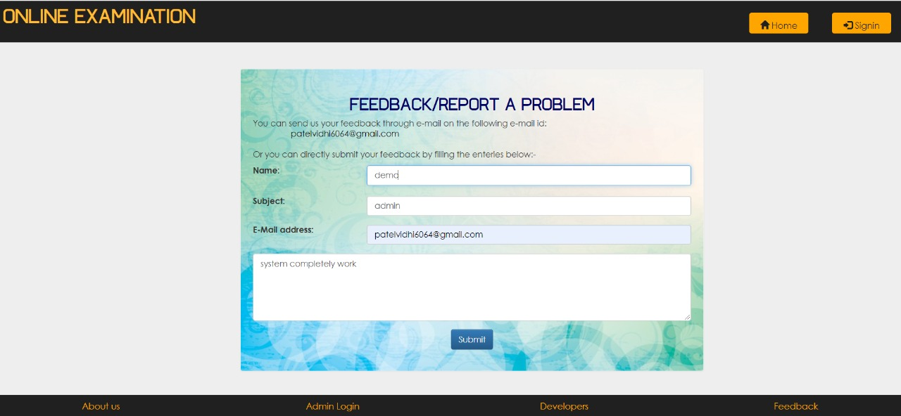

Slide 55
